Slide 1

V
Analysis Of Spatial Patterns and Location based characteristics using machine learning algorithm
Name of the Guide
Mrs. Mohana leela
Assistant professor
Presented By
M.Deepak(20911A04K8)
A.Prashanth(20911A04J8)
K.Jathin(20911A04L6)

Slide 2
CONTENTS
ABSTRACT
INTRODUCTION
EXISTING METHODOLOGY
PROPOSED METHODOLOGY( Including Block Diagram)
RESULTS/OUTCOMES
CONCLUSION
REFERNCES

Slide 3
ABSTRACT
The proliferation of geolocational data has created vast opportunities for extracting valuable insights and understanding human behaviour in relation to location. This project aims to perform an explanatory analysis of geolocational data using the K-means clustering algorithm to uncover hidden spatial patterns, identify distinct groups, and gain a deeper understanding of the underlying structure within the data. The study will leverage a diverse range of geolocational data sources, including GPS traces, check-ins, and geotagged social media posts, along with relevant contextual information. The K-means clustering algorithm will be applied to partition the data into distinct clusters based on spatial proximity, enabling the identification of groups with similar location-based characteristics.

Slide 4
INTRODUCTION
This data science project explores a data engineer's daily life, covering data preparation, visualization, machine learning, and result presentation. It focuses on the importance of food preferences and location for someone new to an area, aiming to find nearby food outlets aligning with their tastes. The project aids convenience, customer satisfaction, and sales. Real-life datasets are collected, preprocessed, and visualized to understand outlet distributions and preferences. Machine learning algorithms recommend nearby outlets based on personal tastes. Results are presented in a user-friendly format, applicable to restaurant managers and hotel owners for strategic location decisions. This beginner-friendly project demonstrates data-driven decision-making's relevance in lifestyle optimization.

Slide 5
EXISTING METHODOLOGY
The existing geolocational data exploration system involves data collection from GPS, smartphones, and social media.
Preprocessing handles errors and missing values, while geospatial visualization reveals patterns on interactive maps.
Spatial analysis uncovers relationships, and GIS tools aid management and analysis. Location-Based Services offer real-time navigation and personalized recommendations.
This system empowers urban planning, transportation, marketing, and disaster management, supporting data-driven decisions.

Slide 6
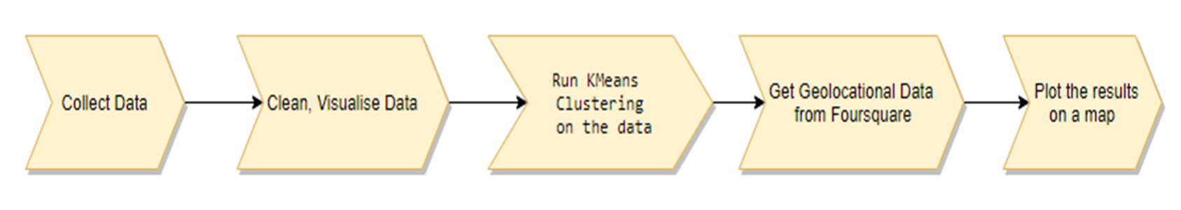
PROPOSED METHODOLOGY( Block Diagram)

Slide 7
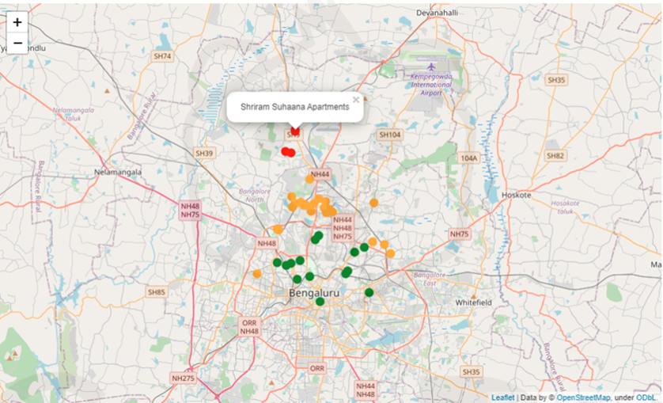
RESULTS/OUTCOMES
Cluster 0(Green) has maximum department stores, cafes and gyms
Cluster 1(Yellow): has minimum stores, cafes and gyms
Cluster 2(Red): has more gyms but less cafes and stores

Slide 8
CONCLUSION
K-Means clustering technique has been used to cluster the data which is taken as a geo-locational data from the Here Geocoding and Search API based on the uses location. We have built a simplistic website that accepts the user location and then outputs a map that has been filled with geographic data clusters. It is user friendly, making it simple to use. This website aids in resolving a problem that affects migrants frequently. With this service, we may find housing options fast that fit our preferences and are useful for migrants. We also included the nearby locations to our website options for restaurants, banks and schools

Slide 9
REFERNCES
[1] M. Sumithra, Sai Pavithra, Sowmya, Swetha, Srinithi. Exploratory Analysis of Geo-Locational Data - Accommodation Recommendation. International Research Journal of Engineering and Technology (IRJET) Volume: 09 Issue: 07 | July 2022.
[2] Gaurang Ajmera, Alok Singh 2018. Hierarchical Data Analysis on Geo-locational Data using Machine Learning.
[3] S. G. K. Patro et al., "A Hybrid Action-Related K-Nearest Neighbor (HAR-KNN) Approach for Recommendation Systems," in IEEE Access, vol. 8, pp. 90978-90991, 2020, DOI: 10.1109/ACCESS.2020.2994056.
[4] Al-Dabooni, S. and Wunsch, D., 2018. Model order reduction based on agglomerative hierarchical clustering. IEEE transactions on neural networks and learning systems, 30(6), pp.1881-1895.
[5] Roger D Peng. Exploratory Data Analysis with R, A book published by Lulu.com in 2016 April 20.

Slide 10
Thank you

